Slide 1
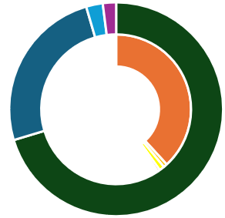
Sample financial life plan For members only
We’ve designed this template to give you an idea of the things you need to consider when creating a financial life plan – you can add your own details to create your personalised plan. (The figures used here are just an example for illustrative and educational purposes.)
Your life:
Your money:
My principles
To max time with partner.
To be self-sufficient.
To be able to enjoy different arts and cultures.
Assets | Liabilities
○ Property: £350,000 | ○ Mortgage: £190,000
○ Pensions: £125,000 | ○ Student loan: £4,000
○ Investments: £12,500 | ○ Other debt: £5,500
○ Cash: £10,000 | ○ Credit cards: £2,600
Your spending plan:
Total income:
Matt’s salary: £45k
Deb’s salary: £45k
Total expenditure
Needs: £60k (65%)
Wants: £22k (25%)
Financial goals: £8k (5%)
Saving nets
Emergency fund: £8k
Transition funds: £4k
Your money-mindset
Matt: Joy-seeker
Deb: Nurturer
Overview
Goals unlikely achievable.
Current expenditures deviate from 50-30-20 rule of thumb.
Emergency funds sufficient.
Protection against job-loss low.
Savings rates low.
My goals
To be mortgage free by 55.
Plan for kids education.
Use ISAs, pensions and allowances more wisely.
Assets
In next 12-18 months
Cut expenses on needs or increase income.
Use ISAs to up transition fund.
Spend more on arts and culture and time together to address money mindset and principles.
Liabilities
Your net worth
assets – liabilities =
£295,400
Aegon UK plc, registered office: Level 26, The Leadenhall Building, 122 Leadenhall Street, London, EC3V 4AB. Registered in England and Wales (No. 03679296). © 2026 Aegon UK plc

